Slide 1
Use of CORDEX Downscaled Data for Hydrologic Impact Assessment
Pradeep Mujumdar
Indian Institute of Science
Bangalore

Slide 2
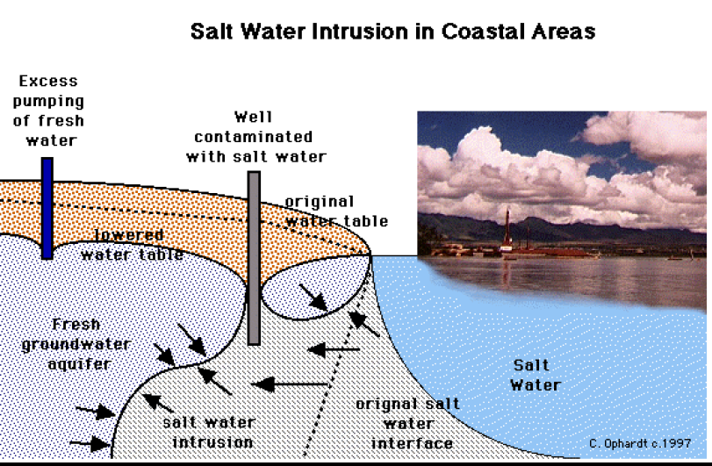
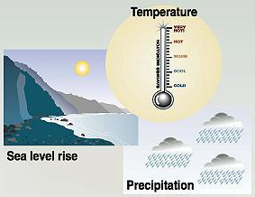
Climate Change – Hydrologic Implications
Increasing Temperatures
  Evapotranspiration
  Water Quality
Change in Precipitation Patterns
  Streamflow; Water availability
  Intensity, Frequency and Magnitude of Floods and Droughts
  Groundwater Recharge
Rise in Sea Levels
  Inundation of coastal areas
  Salinity Intrusion
Fig. Source: ww.engr.uconn.edulanboG229Lect111SWIntru.pdf

Slide 3
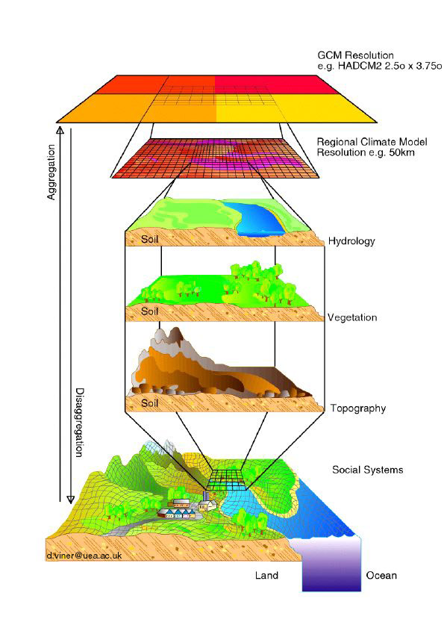
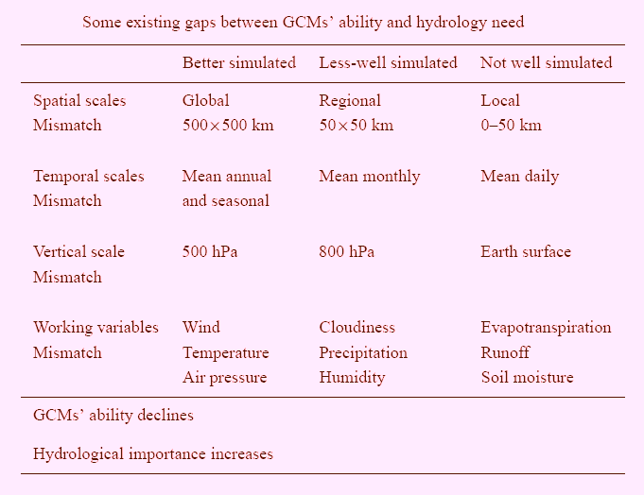
Need for Downscaling – Hydrologic Impact Assessment
Source: Xu Chong-Yu, Water Resources Management 13: 369–382, 1999.

Slide 4
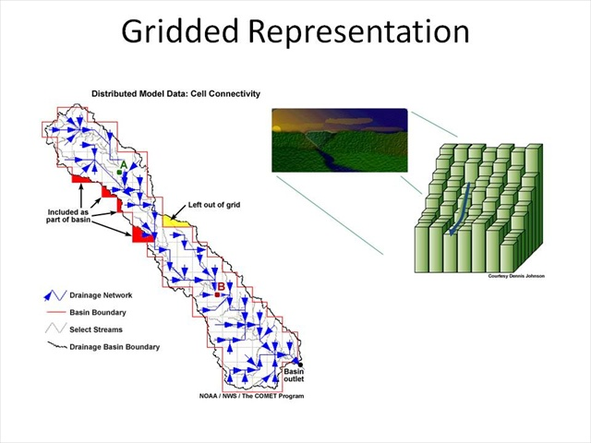
Distributed hydrologic models
Source: University Corporation for Atmospheric Research (UCAR)
Simulate Streamflow, Evapotranspiration, Soil Moisture, Deep percolation, Detention Storage and other surface water processes

Slide 5
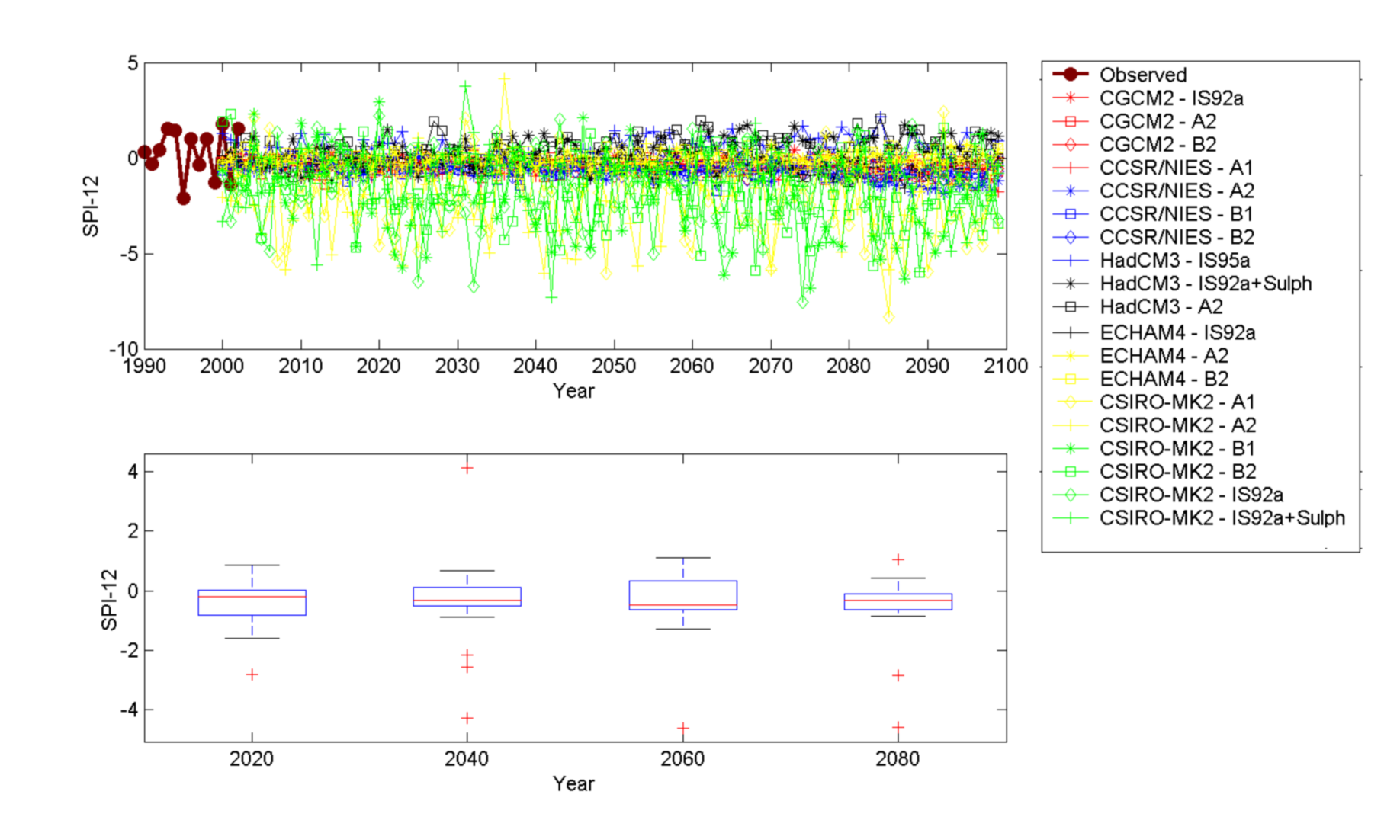
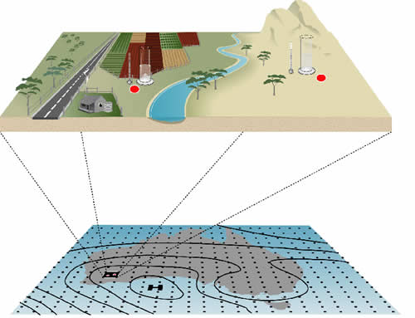
Downscaling & uncertainties of the GCM outputs to the river basin scales
Challenge:
Quantification and Reduction of Uncertainties

Slide 6
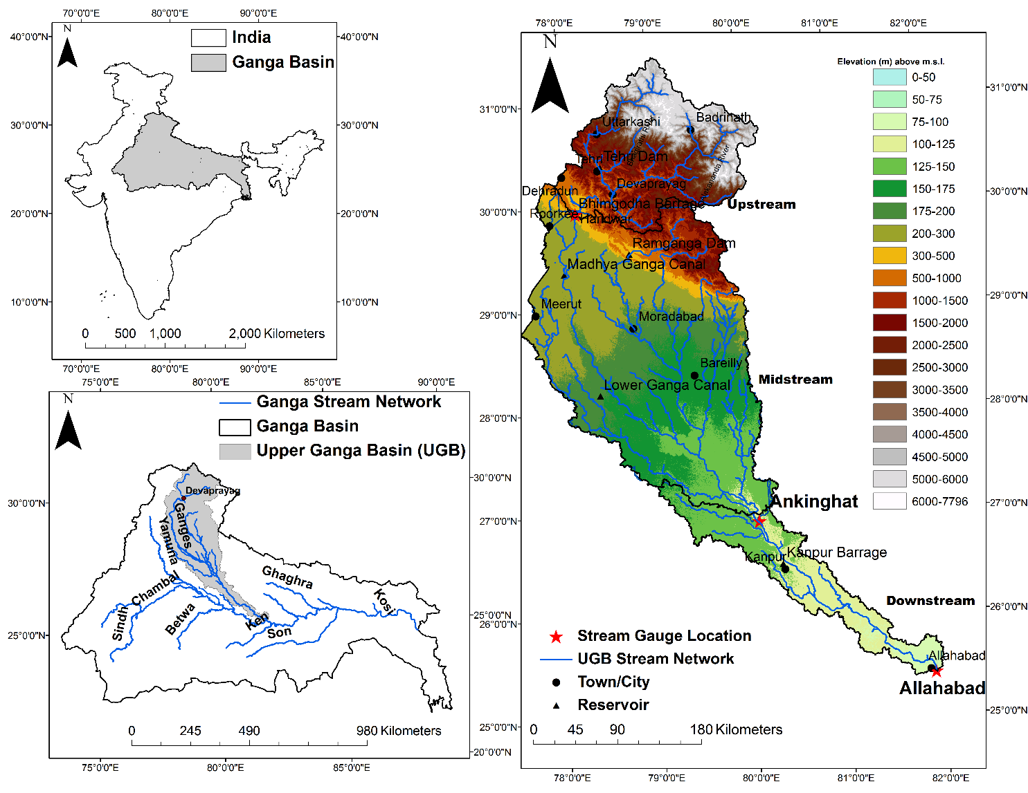
Study Area: Upper Ganga Basin (UGB)
Latitude: 25°30'N to 31°30'N; Longitude: 77°30'E to 80°E
Catchment area – 95,593 km²
Elevation profile – 21 m to 7796 m
Average annual rainfall over the UGB varies from 500 mm to 2500 mm.
Average annual temperature of the basin is around 21°C.

Slide 7
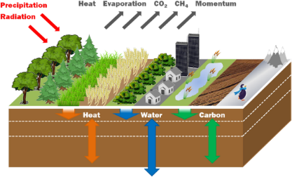
Model Structure
A systems approach with coupling between atmosphere, land surface and groundwater systems.
MetUM: CAM4
(Climate model runs)
Soil Moisture; Evapotranspiration
CLUE-S
(Land use
change model)
CMIP5
(Ensemble of
climate models)
Projection of
water resources
VIC/JULES
(Land surface model)
Downscaling and Uncertainties
ZOODRM
(Groundwater model)
Policy options

Slide 8
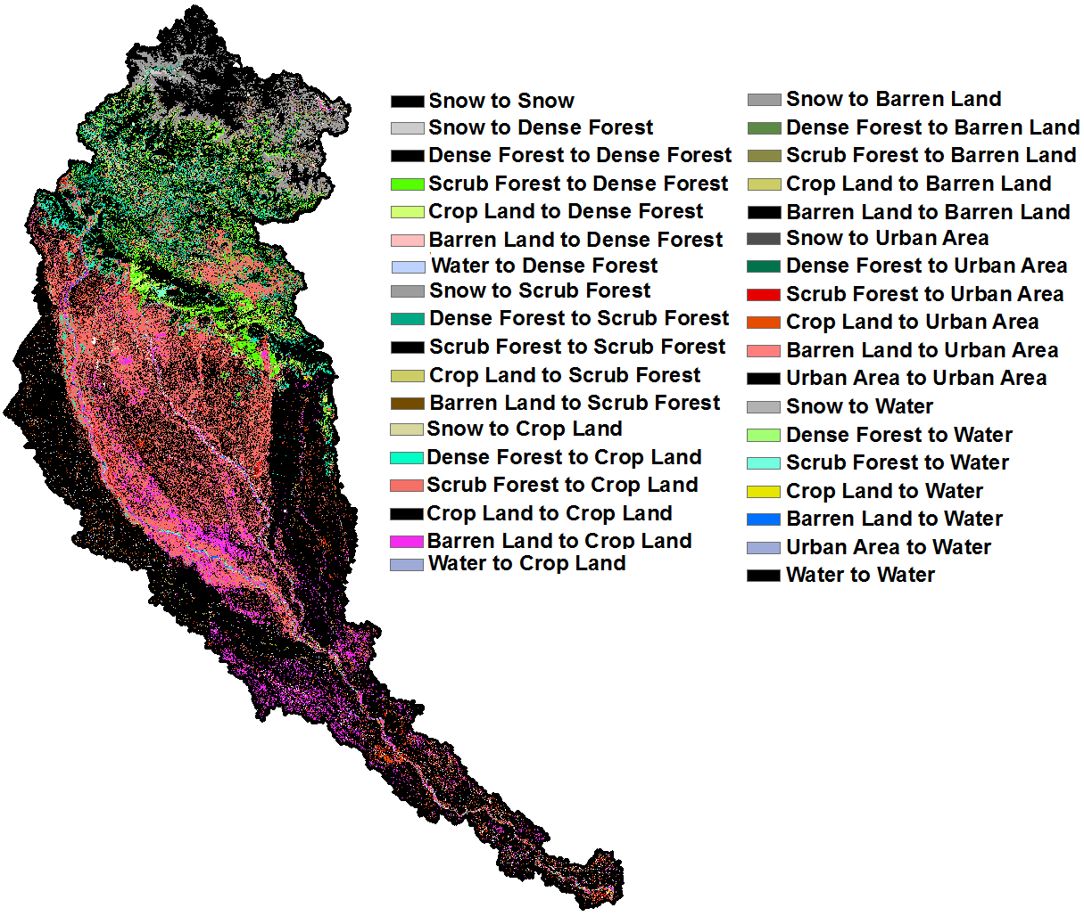
LULC Analysis: Change Location Map
Scrub to crop land
Barren to crop land
Change location map of UGB between 1973-2011

Slide 9
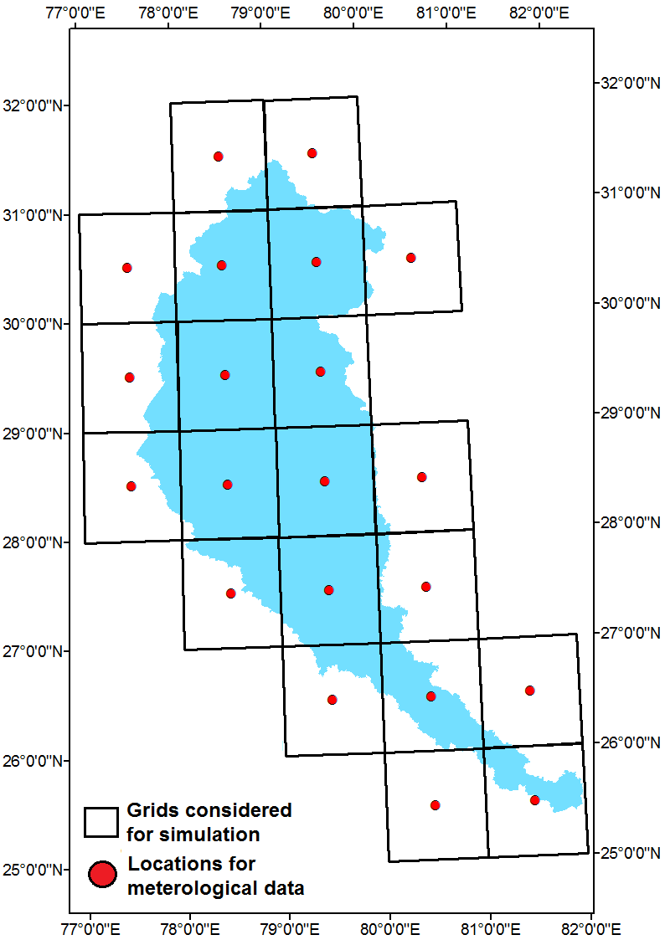
Hydrologic Modeling: Meteorological Input
Meteorological Data
For each grid four meteorological variables are considered at daily time scale
List of meteorological variables
S. No. | Variable | Unit | Source
1 | Precipitation | mm | IMD
2 | Maximum Temperature | °C | IMD
3 | Minimum Temperature | °C | IMD
4 | Wind Speed | m/s | Princeton University
Map of the UGB showing the meteorological data grid points along with VIC grids

Slide 10
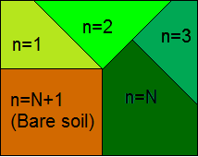
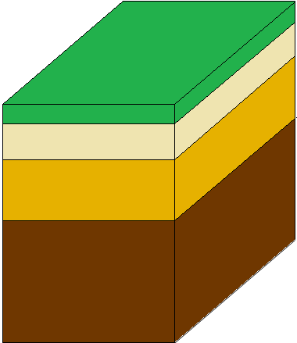
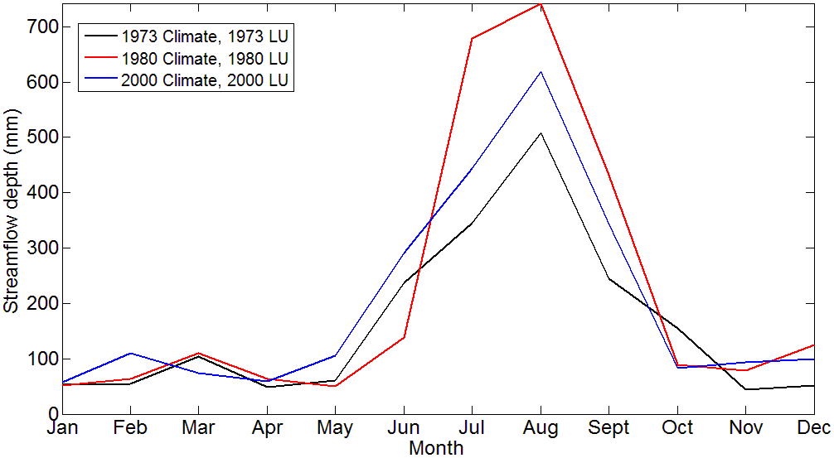
Hydrologic Modelling
Carried out at IISc, Bangalore and Imperial College, London
IISc :
  Setting up the Variable Infiltration Capacity (VIC) hydrologic model at 0.5 degree resolution over the Upper Ganga basin
  Evaluating the effect of land use and climate on hydrological regime of the basin using VIC model.
  Isolating the individual impact of land use and climate change on streamflow
  Climate change is the dominant contributor to the observed streamflow changes
E_{c}
E_{t}
P
Land-cover classes
E₁
Canopy
Q_{d}
P = Precipitation
E_{t} = Evapotranspiration
E_{c} = Canopy Evaporation
E₁ = Baresoil Evaporation
Q_{d} = Direct Runoff
I = Infiltration
Q₁₂ = Gravity flows layer 1 to 2
Q₂₃ = Gravity flows layer 2 to 3
W₁, W₂, W₃ = Water content in respective layers
Q_{b} = Subsurface Flow
Layer 1
(0 – 10 cm)
W₁
Layer 2
(10 – 40 cm)
Q₁₂
W₂
I
Q₂₃
Layer 3
(40 – 100 cm)
W₃
Q_{b}
Hydrologic impacts of LULC and climate

Slide 11
Projecting Climate Change Impacts on Hydrology
Climate Change Projections (precipitation, temperature, radiation, humidity)
Topography, Land-use/Land Cover ; Soil characteristics; Other catchment data
Downscaling
Hydrologic Model
Possible Future Hydrologic Scenarios on Basin Scale
(Streamflow, Evapotranspiration, Soil Moisture, Infiltration, Groundwater Recharge etc.)

Slide 12
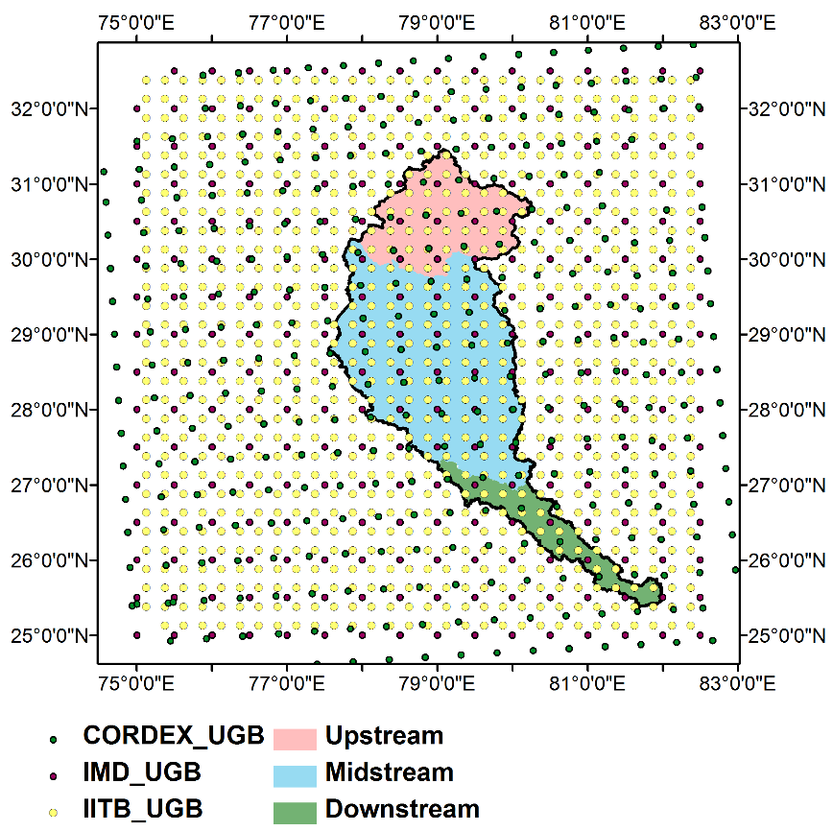
Location of IIT-B and Cordex Downscaled Data Grid Points along with IMD Grid Points
Resolution of IMD data: 0.5° × 0.5 °
Resolution of downscaled IIT-B data: 0.25 ° ×0.25 °
Resolution of cordex data: ~0.44 ° ×0.44 °

Slide 13
Climate Data from CORDEX
Projections of Rainfall (P), maximum temperature (T_{max}), minimum temperature (T_{min}) and wind speed (W) – procured from CORDEX South Asia group at daily scale
GCMs from the CORDEX project used in the study
Modeling Center-Experiment Name | Driving GCM (Abbreviation) | Institution
Commonwealth Scientific and Industrial Research Organization, (CSIRO) Australia CCAM | ACCESS1.0 (ACC) | CSIRO
 | CNRM-CM5 (CNR) | Centre National de Recherches Meteorologiques
 | CCSM4 (CCS) | National Center for Atmospheric Research
 | GFDL-CM3 (GFD) | Geophysical Fluid Dynamics Laboratory
 | MPI-ESM-LR (MPI) | Max Planck Institute for Meteorology (MPI-M)
 | NorESM1-M (NOR) | Norwegian Climate Centre
Climate variables obtained from the GCMs were bias corrected with respect to the IMD gridded data at daily scale.

Slide 14
Summary Measures for Upstream Region – Future Projections (2010-2099)
Observed Discharge Mean (Historical) = 776.97 cumecs
Observed Discharge Std. Dev. (Historical) = 802.85 cumecs
 |  | RCP 2.6 |  | RCP 4.5 |  | RCP 8.5
 |  | Mean (cumecs) | Std. Dev. (cumecs) | Mean (cumecs) | Std. Dev. (cumecs) | Mean (cumecs) | Std. Dev. (cumecs)
CORDEX - CSIRO | ACCESS1.0 | - |  | 1041.42 | 795.00 | 1069.94 | 841.89
 | CCSM4 |  |  | 1096.24 | 1076.87 | 1058.91 | 833.90
 | GFDL-CM3 |  |  | 792.93 | 678.61 | 1071.20 | 839.43
 | CNRM-CM5 |  |  | 1049.56 | 791.20 | 1049.87 | 834.20
 | MPI-ESM-LR |  |  | 1040.74 | 797.05 | 1082.43 | 878.48
 | Nor-ESM-M |  |  | 1046.66 | 789.09 | 1084.37 | 813.19
IITB - Models | BCC | 880.34 | 622.96 | 868.68 | 611.38 | 870.87 | 602.27
 | CCCMA | 874.86 | 607.87 | 895.97 | 632.23 | 879.68 | 610.76
 | IPSL | 876.63 | 633.12 | 893.98 | 623.28 | 908.27 | 620.27
 | MIROC | 845.29 | 570.38 | 835.93 | 560.14 | 859.81 | 590.88
 | Nor-ESM-M | 886.86 | 621.64 | 879.95 | 605.09 | 896.12 | 613.65
 | Ensemble | Mean (cumecs) |  |  | Std. Dev. (cumecs)
 |  | 944.52 |  |  | 597.14

Slide 15
Analysis of Climate Data from CORDEX - Overall
Taylor diagram for (a) P (mm) (b) T_{max} (°C) and (c) T_{min} (°C) for upstream region
Models are observed to be clustered - all the GCM outputs are from the same modelling center
Model outputs for T_{max} and T_{min} are closer to the observed data (represented by point ‘a’) - reflecting better quality of GCM outputs for T
Correlation of 0.6-0.7 was obtained between GCM P and observed P – considered acceptable

Slide 16
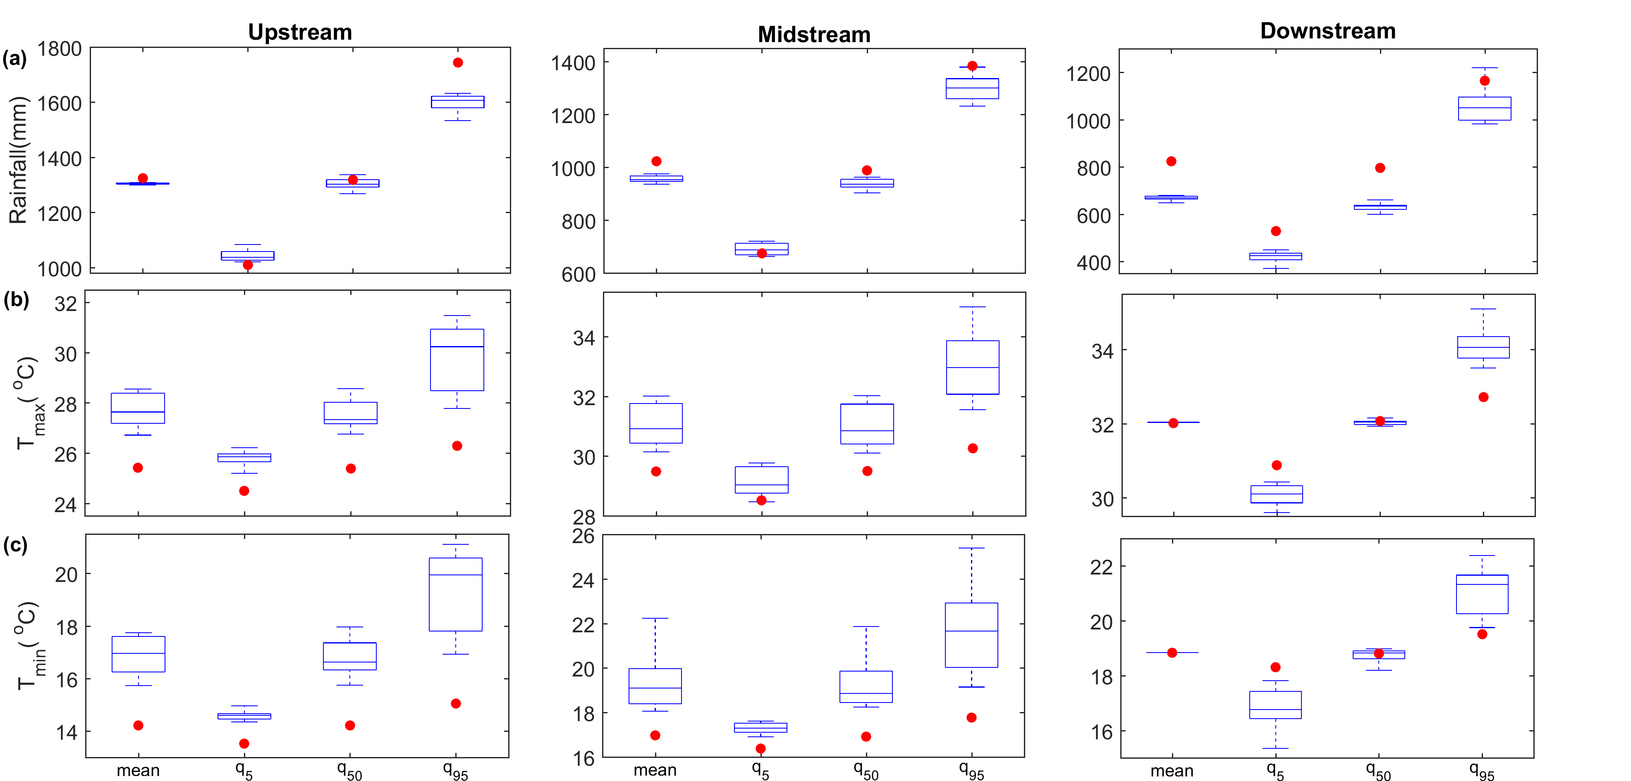
Analysis of Climate Data from CORDEX – Overall at Annual Scale
In general, annual P may decrease across all the three regions in the UGB in future compared to historic/observed values.
Annual T_{max} and T_{min} in upstream and midstream region is found to increase in future time periods.
Higher variability amongst the model values is observed for q₉₅ – higher uncertainty in the GCMs to simulate extreme events.
Comparison between annual (a) rainfall; (b) maximum temperature; and (c) minimum temperature during historic and future time periods for upstream; midstream; and downstream regions of the UGB
Red dots : observed data

Slide 17
Analysis of Climate Data from CORDEX
GCM outputs for future time period – aggregated into five time slices:
T1 (2010-2020), T2 (2021-2040), T3 (2041-2060), T4 (2061-2080) and T5 (2081-2100).
Comparisons made between the annual means of the future time slices’ and the baseline period (1971-2005)
Monthly variability in P – decline during monsoon months and increase during winter months – result in shift in
seasonal pattern of P
Longitudinally from upstream to downstream – variations in P in downstream region are much more severe.
Change in ensemble mean of P, T_{max} and T_{min} from the baseline period for RCR 4.5 (first bar of every time slice of all the plots) and RCP 8.5 (second bar of every time slice of all the plots) scenarios at each time slice
Monthly mean T_{max} and T_{min} – increase significantly during winter months and decline during April to September in all the regions.
Longitudinally from upstream to downstream – downstream region may experience maximum increase in the mean T_{max} and T_{min.}

Slide 18
Climate Change Effect on Streamflow
LU is kept fixed for 1971 – climate varied continuously for the baseline period (1971-2005) and future scenarios (2010-2100).
Simulation results obtained were compared with the baseline simulation results.
Runoff ratio (RR) is computed:
Runoff Ratio across time slices for upstream, midstream and downstream regions
(terms in parentheses indicate the percent change from the baseline values)
Region | Time Period | Rainfall (mm) |  | Runoff (mm) |  | Runoff Ratio
 |  | RCP 4.5 | RCP 8.5 | RCP 4.5 | RCP 8.5 | RCP 4.5 | RCP 8.5
Upstream | Baseline | 1294 | 1294 | 772 | 772 | 0.60 | 0.60
 | T1 | 1196±172 (-8) | 1210±46 (-7) | 697±84 (-10) | 683±32 (-12) | 0.58 (-2) | 0.56 (-4)
 | T2 | 1084±480 (-16) | 1257±43 (-3) | 619±287 (-20) | 715±30 (-7) | 0.57 (-3) | 0.57 (-3)
 | T3 | 1377±171 (+6) | 1323±32 (+2) | 816±137 (+6) | 771±26 (0) | 0.59 (-1) | 0.58 (-2)
 | T4 | 1416±198 (+9) | 1357±42 (+5) | 845±163 (+9) | 800±38 (+4) | 0.60 (0) | 0.59 (-1)
 | T5 | 1424±182 (+10) | 1405±27 (+9) | 854±148 (+11) | 842±26 (+9) | 0.60 (0) | 0.60 (0)

Slide 19
Climate Change Effect on Streamflow
RR ‒ 60% for the upstream region, 44% for the midstream region and 23% for the downstream region during the baseline period.
Upstream region ‒ characterized by mountainous terrain and steep slopes, most of the P gets converted to Q_{clim} (high RR).
Downstream region ‒ flat terrain, much of the P get evaporated or infiltrated into soil and little gets converted to Q_{clim} (low RR).
P does not change significantly from the baseline period, increase in T results in reduced RR.
The RR is observed to increase and approach towards baseline RR with slight increase in P (irrespective of change in T)
T3 and T4 (RCP 4.5 and RCP 8.5) for downstream region, P is observed to reduce accompanied by an increase in T – reduction in RR is not observed
This anomaly could be attributed to occurrence of short duration dense rainfall events in the region.
Region | Time Period | Rainfall (mm) |  | Runoff (mm) |  | Runoff Ratio
 |  | RCP 4.5 | RCP 8.5 | RCP 4.5 | RCP 8.5 | RCP 4.5 | RCP 8.5
Midstream | Baseline | 1009 | 1009 | 441 | 441 | 0.44 | 0.44
 | T1 | 844±84 (-16) | 871±63 (-14) | 323±31 (-27) | 328±56 (-25) | 0.38 (-12) | 0.38 (-4)
 | T2 | 787±265 (-22) | 884±53 (-12) | 296±115 (-33) | 332±52 (-25) | 0.38 (-12) | 0.38 (-12)
 | T3 | 1003±135 (-1) | 952±31 (-6) | 413±77 (-6) | 378±20 (-14) | 0.41 (-3) | 0.40 (-4)
 | T4 | 1062±159 (+5) | 1016±28 (+1) | 462±101 (+5) | 427±23 (-3) | 0.44 (0) | 0.42 (-2)
 | T5 | 1071±160 (+6) | 1058±21 (+5) | 471±121 (+7) | 452±21 (+3) | 0.44 (0) | 0.43 (-1)
Downstream | Baseline | 826 | 826 | 192 | 192 | 0.23 | 0.23
 | T1 | 579±63 (-30) | 590±55 (-29) | 102±13 (-47) | 107±19 (-44) | 0.18 (-5) | 0.18 (-5)
 | T2 | 557±183 (-32) | 589±40 (-29) | 89±43 (-54) | 104±13 (-46) | 0.16 (-7) | 0.18 (-5)
 | T3 | 721±108 (-13) | 663±38 (-20) | 141±34 (-27) | 127±13 (-34) | 0.20 (-3) | 0.19 (-4)
 | T4 | 743±128 (-10) | 731±23 (-11) | 150±46 (-22) | 148±7 (-23) | 0.20 (-3) | 0.20 (-3)
 | T5 | 785±101 (-5) | 771±37 (-6) | 173±36 (-10) | 167±16 (-13) | 0.22 (-1) | 0.21 (-2)

Slide 20
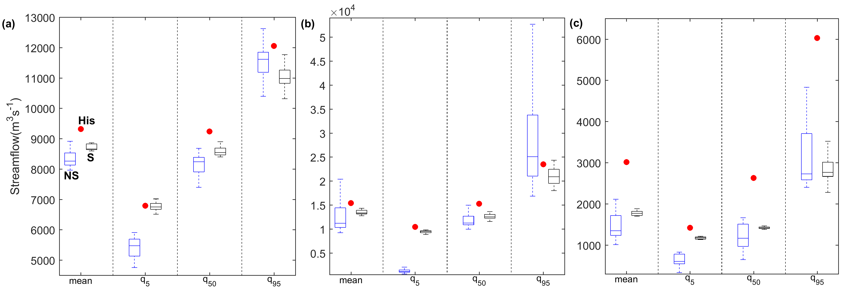
Hydrologic Impacts of Future Land Use and Climate Change
48 streamflow simulations under each nonstationary and stationary model conditions are obtained – 6 GCMs * 2 emission scenarios * 4 LU scenarios
Nonstationary : Model parameters are varied for future simulations
Stationary: Model parameters, as obtained for historic time period are used for future simulations
Annual mean and quantile values of streamflow for (a) Upstream; (b) Midstream; and (c) Downstream regions of the UGB under future conditions with stationary (S) and nonstationary (NS) model conditions and historic (His) time periods
Streamflow is noticed to decrease in future for both nonstationary and stationary conditions – decrease in rainfall and increase in temperature obtained for future projections

Slide 21
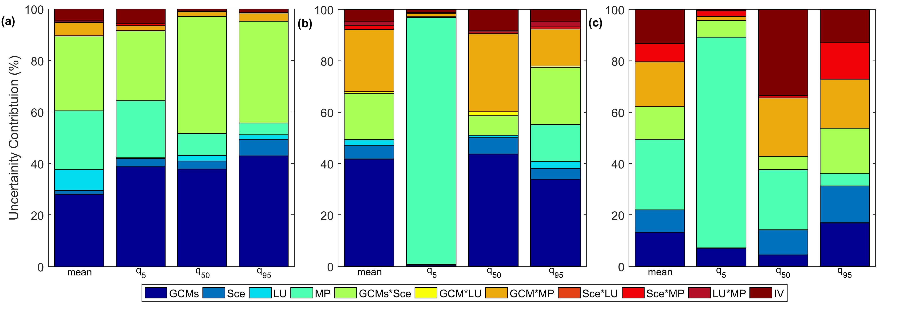
Uncertainty Contribution from Different Sources
Total uncertainty in the streamflow projections is decomposed to individual components – (i) GCMs, (ii) emission scenarios (Sce), (iii) Land Use (LU), (iv) hydrologic model parameters (MP) – assumed to be stationary or nonstationary, and (v) and internal variability (IV) of the system using the ANOVA approach
Contribution of different factors to total uncertainty of annual streamflow projections (change in mean, 5th quantile, 50th quantile and 95th quantile) for (a) Upstream; (b) Midstream; and (c) Downstream regions of the UGB under both stationary and nonstationary model conditions
GCMs + Scenarios and Model Parameter assumption of nonstationarity and stationarity are observed to be significant sources of uncertainty

Slide 22
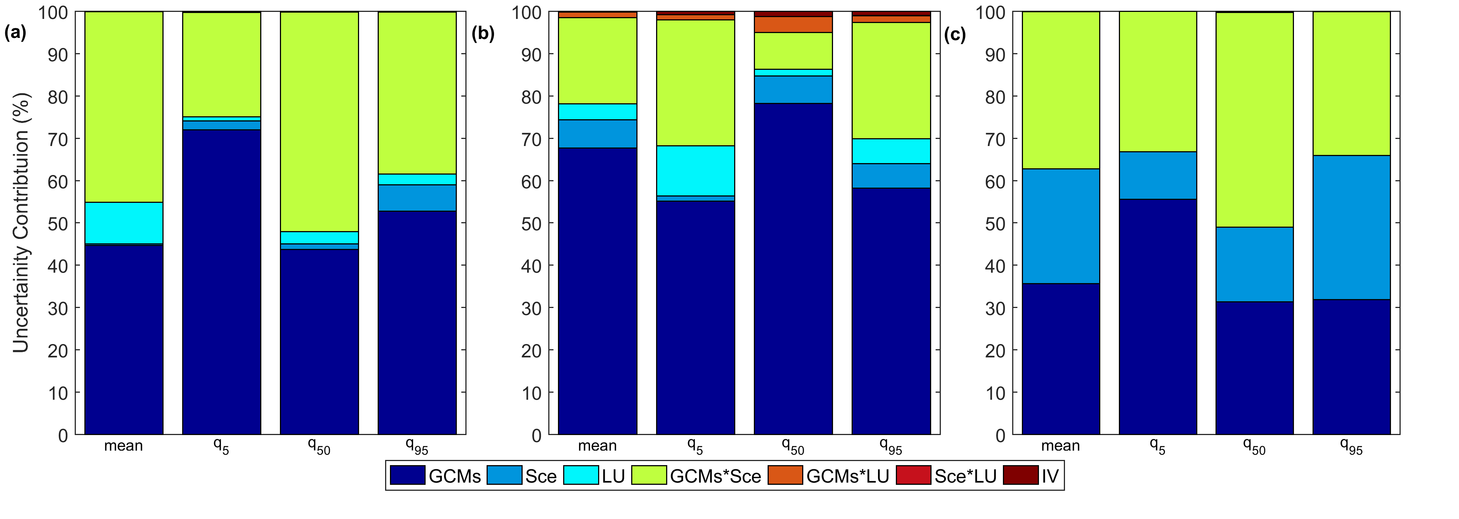
Uncertainty Contribution from Different Sources
In the nonstationary case, GCMs and Sce are observed to be the dominant contributor to total uncertainty in streamflow across all the cases.
Contribution from LU is also noticeable across all the cases
Contribution of different sources to total uncertainty of annual streamflow projections (change in Mean, 5th quantile, 50th quantile and 95th quantile) obtained under nonstationary model condition for (a) Upstream; (b) Midstream; and (c) Downstream regions of the UGB

Slide 23
Concluding Remarks
CORDEX output is useful in assessing hydrologic impacts – a larger number of GCMs and scenarios would be useful in addressing uncertainties.
It is possible to partition the uncertainties arising from different sources, in the Hydrologic Impacts : Climate Models, Scenarios, Hydrologic Model Parameters, Land Use Change
Quantification and reduction of uncertainties in the impact assessment models is critical.

